Slide 1
Writing Administrative Scripts using PowerShell
Notes:
The lecture introduces students to the new world of Windows PowerShell scripting. You will learn how to call cmdlets and use pipelining from the interactive console windows. You will also learn how to write, test and debug Windows PowerShell scripts using the Windows PowerShell Integrated Scripting Environment (ISE). Finally, you will learn how to load the SharePoint PowerShell snap-in and call cmdlets provided by SharePoint 2010.

Slide 2
Agenda
Introduction to Windows PowerShell
The Windows PowerShell console window
Writing Windows PowerShell scripts
Using the SharePoint PowerShell Snap-in

Slide 3

PowerShell Support
Previous version of WSS relies on STSADM.EXE
Used for command line administration and scripting
SharePoint 2010 adds support for PowerShell
PowerShell support effectively replaces STSADM.EXE
SharePoint IT Pros must learn PowerShell basics
You can write scripts using SharePoint object model
STSADM.EXE
We’ll miss you old friend
Notes:
The previous version of SharePoint relies on STSADM.EXE. This command line utility is still there in SharePoint 2010 but it is strongly advised to use the Windows PowerShell scripts that come with SharePoint 2010.
Windows PowerShell is a command line utility that builds on top of the .NET Framework. You can execute commands at the command line, but you can also write powerful scripts to execute support tasks for SharePoint.
Windows PowerShell is an extensible scripting language and allows you to develop your own custom Windows PowerShell snap-ins. These snap-ins can be developed using tools like Visual Studio and using languages like C# and VB.NET.

Slide 4
PowerShell 101
What is PowerShell?
A modern replacement for the CMD (command) shell
A powerful scripting environment for administration
How do you use PowerShell?
From an interactive command window
By writing and executing scripts
Notes:
Over the last few years, PowerShell scripting has begun to replace older DOS-style batch files and VBScript files as the preferred way to manage and automate administrative tasks.
Cmdlets are callable functions.
Pipelining allows one Cmdlet to return an object as input to another.
PowerShell includes formatting features to display output using lists or tables.
PowerShell is based on a provider-based model based on Snap-ins.
SharePoint support is added through Microsoft.SharePoint.Powershell.dll

Slide 5


PowerShell Cmdlets
PowerShell libraries contain Cmdlets
Cmdlets are functions named using Verb-Noun format
Most cmdlets are defined to accept parameters
Notes:
Cmdlets perform an action and typically return a Microsoft .NET Framework object to the next command in the pipeline.
Windows PowerShell uses a verb-noun pair for the names of cmdlets. For example, the Get-Command cmdletprovided by Windows PowerShell is used to retrieve all the commands that are registered in Windows PowerShell. The verb part of the name identifies the action that the cmdlet performs. The noun part of the name identifies the entity on which the action is performed.

Slide 6
Agenda
Introduction to Windows PowerShell
The Windows PowerShell console window
Writing Windows PowerShell scripts
Using the SharePoint PowerShell Snap-in

Slide 7
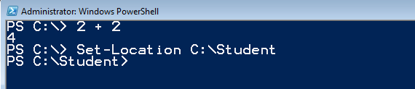


Windows PowerShell Console Window
Type in command or Cmdlet and press Enter
Pressing Enter key executes current line
Tab completion
Hitting Tab completes name of Cmdlet or parameter
Notes:
There is tab completion for the commands and for the members. For example you can type “Install-SP” and then press tab and it will cycle through the available commands. You can also use the tab key to add the parameters to the command.

Slide 8
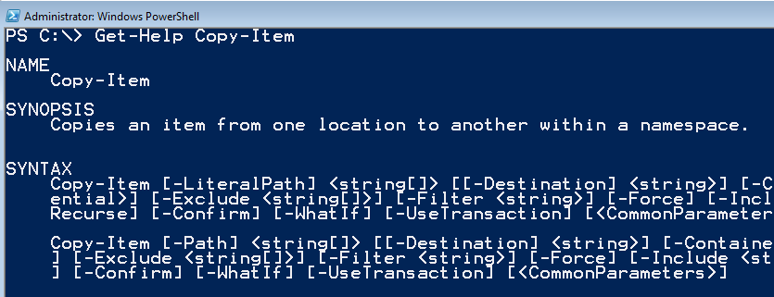

Getting Help on Cmdlet Syntax
Call Get-Help cmdlet passing cmdlet name
Additional parameters can be passed to Get-Help
Notes:
To get help for a command or concept, type "Get-Help" followed by the name of the command or concept help topic. To get a list of all cmdlet help topic titles, type "get-help *".
Get-Help also has a search feature that searches cmdlet help, provider help, and About help (HelpFile) topics. If you type "Get-Help" followed by the exact name of a help topic, or by a word unique to a help topic, Get-Help displays the topic contents. If you enter a word or word pattern that appears in several help topic titles, Get-Help displays a list of the matching titles. If you enter a word that does not appear in any help topic titles, Get-Help displays a list of topics that include that word in their contents.
Because the search feature does not search the help topics for functions and scripts, you must enter the exact name of the function or script to get its help topic.

Slide 9
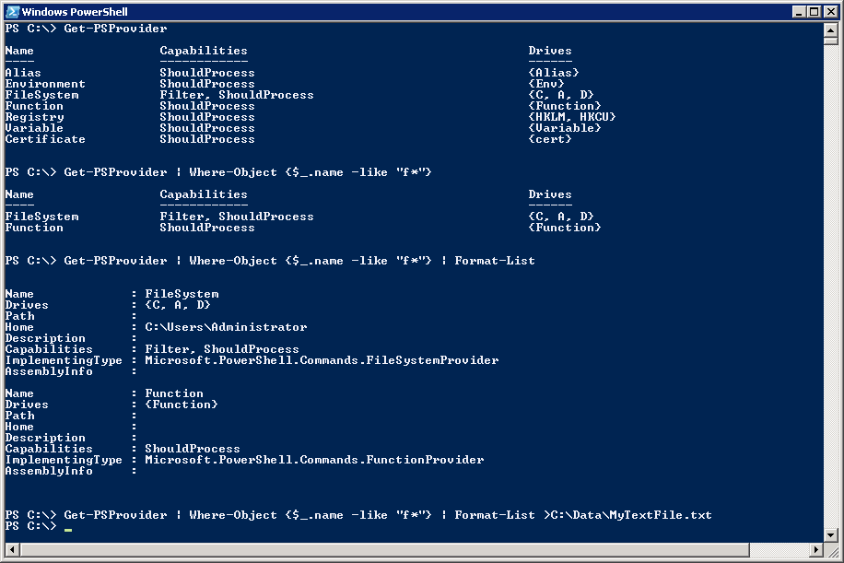
Getting Started with PowerShell
(1) Execute a Cmdlet
(2) Filter results using where clause
(3) Add formatting instructions
(4) Redirect output to new text file
Notes:
The first example shows calling a Cmdlet that takes no parameters
The second example adds filtering by adding a Where command
Where-Object {$_.name –like “f*"}
The syntax $_ refers to the object in question
$_.name refers to the object's name property
-like is the operator for like
The third example adds in formatting instructions
The last example redirects output so it is stored in a new text file.

Slide 10
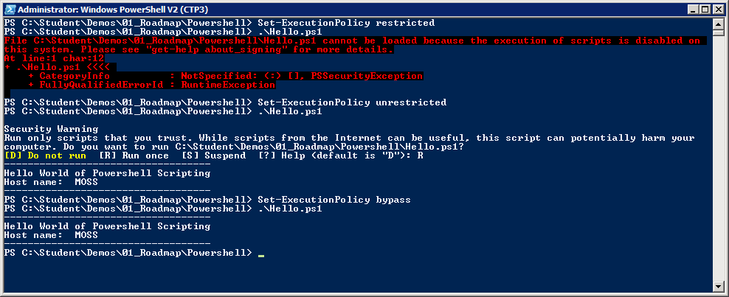
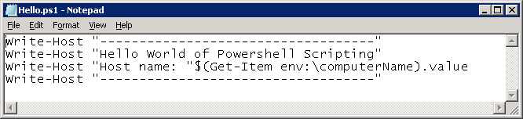
Scripts and Execution Policy
You can author PowerShell scripts
Scripts have *.ps1 extension
Local execution policy must be configured
Scripts will not execute under default execution policy of restricted
Scripts can execute under execution policy of unrestricted. Scripts that are not signed result in prompting user for permission to execute.
Scripts can execute under execution policy of bypass. This mode suppresses prompting user for permission to execute.
Notes:
By default, Powershell does not allow script to run. The SharePoint Administrator must change execution policy to enable script execution
There are a number of settings that you can apply to Execution Policy:
restricted (default) – scripts prohibited from executing
unrestricted - scripts can execute. Scripts that are signed can run with user interaction. Scripts that are not signed result in prompting user for permission to execute.
bypass (developer mode) – scripts can execute and user interaction is suppressed.

Slide 11
DEMO
Interacting with the Windows PowerShell console window

Slide 12
Agenda
Introduction to Windows PowerShell
The Windows PowerShell console window
Writing Windows PowerShell scripts
Using the SharePoint PowerShell Snap-in

Slide 13
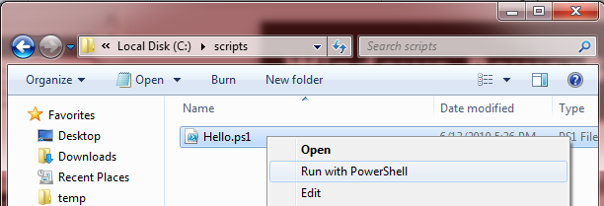
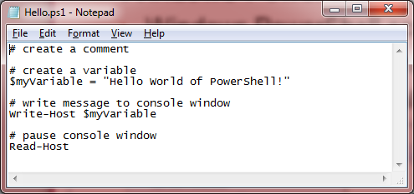
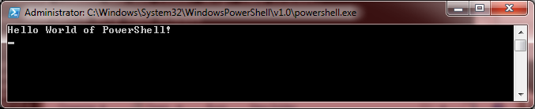
Windows PowerShell Scripting
Windows PowerShell Scripting Fundamentals
Host machine has a configurable execution policy
Execution policy must allow scripts to run
Right-click .ps1 file and select Run with PowerShell to execute
Script Editing Tools
Windows Notepad
Windows PowerShell ISE
Notes:
Windows PowerShell has security settings called the “execution policy”; the execution policy determines how (or if) PowerShell runs scripts. By default, PowerShell’s execution policy is set to Restricted; that means that scripts, including those you write yourself, won’t run.This execution policy can be changed to be able to run scripts. Scripts have the extension of .ps1.
The Windows PowerShell Integrated Scripting Environment (ISE) is a host application for Windows PowerShell. In Windows PowerShell ISE, you can run commands and write, test, and debug scripts in a single Windows-based graphic user interface.

Slide 14
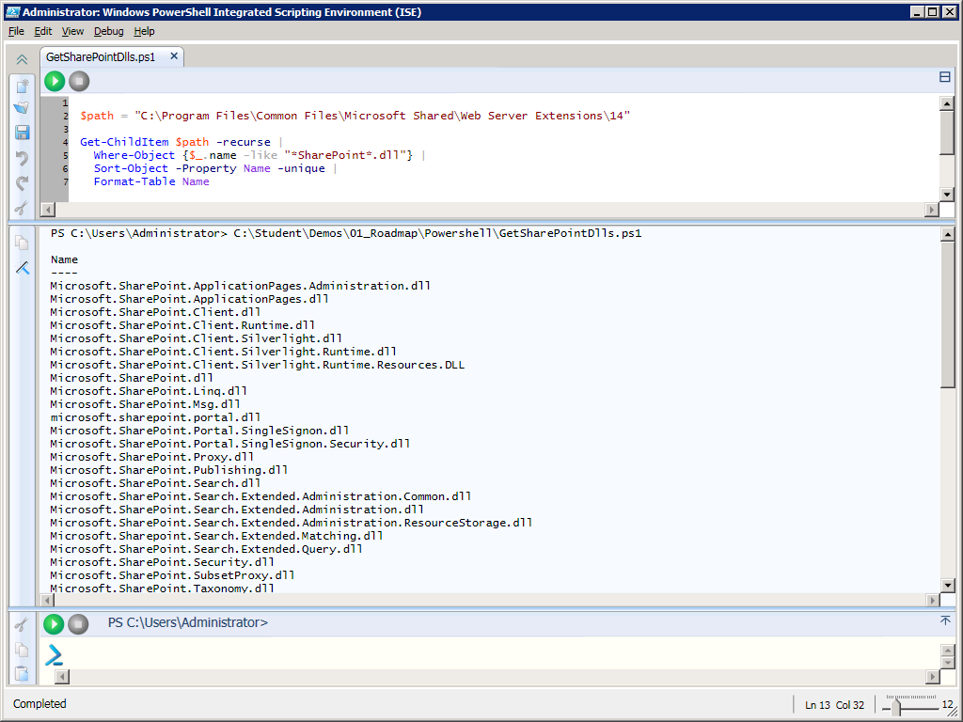
Editing Scripts using PowerShell ISE
Supports color-coding, IntelliSense and debugging
Notes:
With the initial release of Powershell, administrators and developers usually resorted to writing scripts with NotePad. PowerShell 2 provides a nice development environment for writing PowerShell scripts named the PowerShell Integrated Scripting Environment (ISE).
This interface allows for multiline editing, tab completion, syntax coloring, selective execution, context-sensitive help, and support for right-to-left languages. You can use menu items and keyboard shortcuts to perform many of the same tasks that you would perform in the Windows PowerShell console.
When it comes to writing complex scripts with control of flow logic, it is really nice to be able to debug and single step through your code.

Slide 15
Scripting Syntax
Syntax | Description
# | Creates a comment
$ | Creates a variable
; | Denotes completion of cmdlet, continue to next one
| | Pipelines output of the preceding cmdlet to next cmdlet
ForEach-Object { } | For each object, execute all the commands within the { }.
Notes:
Windows PowerShell is fundamentally case insensitive. Every object and every cmdlet is case insensitive. Set-Location performs exactly the same action as set-location. However, where your data has case sensitive values, there are PowerShell operators to deal with it.
Variable names always start with a dollar sign ($) and can contain a mix of letters, numbers, symbols, or even spaces (though if you use spaces, you need to enclose the variable in braces)
$var = “Hello”
The pipe (|) symbol is used to pipe commands. The output of one command serves as input for the second command.
Get-Command -PSSnapin Microsoft.SharePoint.PowerShell | Out-Gridview
Get-SPWeb http://intranet.wingtip.com | get-member
Get-SPWeb http://intranet.wingtip.com | gm
ForEach-Object can be used to execute a loop
Ex:
$Jobs = @(Get-SPTimerJob | Where-Object { $_.Schedule.Interval -le 5 -and $_.Schedule.Description -eq "Minutes" })
foreach ($job in $Jobs) {
Write-Host -foregroundcolor green $job.name
$Sched = $job.Schedule
$Sched.Interval= $Sched.Interval+30
$job.Schedule=$Sched
$job.Update()
}
Filtering example:
Get-SPTimerJob | Where-Object { $_.Schedule.Description -eq "Minutes" }

Slide 16
DEMO
Writing Scripts with the
Windows PowerShell ISE

Slide 17
Agenda
Introduction to Windows PowerShell
The Windows PowerShell console window
Writing Windows PowerShell scripts
Using the SharePoint PowerShell Snap-in

Slide 18
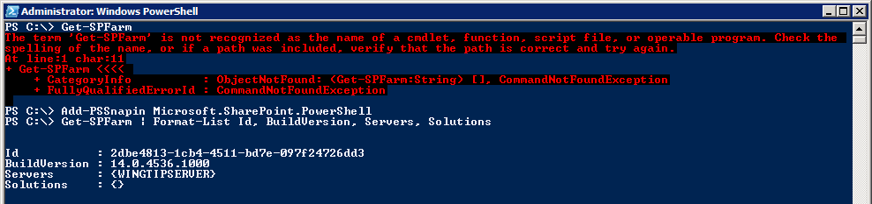
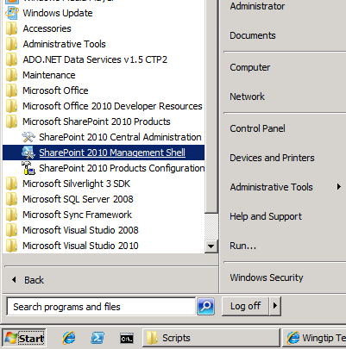
The SharePoint Powershell Snapin
Explicitly load SharePoint PowerShell snap-in from console or script
Implicitly load snap-in by using link in Windows Start menu
Begin using SharePoint Cmdlets
Notes:
SharePoint Server 2010 adds many Cmdlets for SharePoint administration through a Snap-in provider named Microsoft.SharePoint.PowerShell. The SharePoint cmdlets cannot be called until the SharePoint snap-in has been loaded.
There are two common ways to load the SharePoint snap-in:
Call the Add-PSSnapincmdletand pass a parameter with the snap-in name
Launch the PowerShell console using SharePoint Management Console. This link points to an XML file that loads the SharePoint snap-in in a declarative fashion.

Slide 19
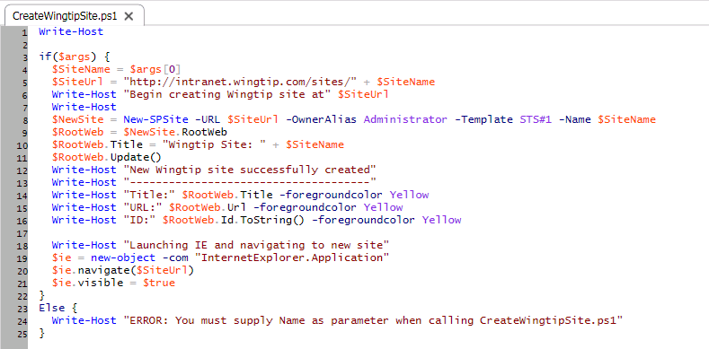
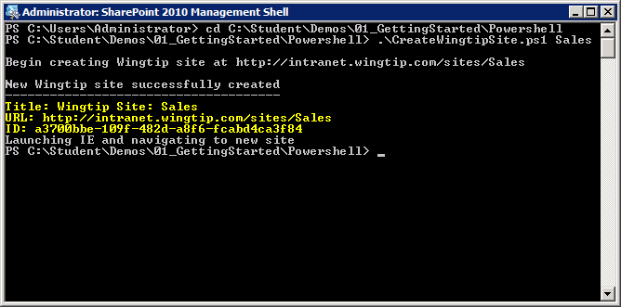
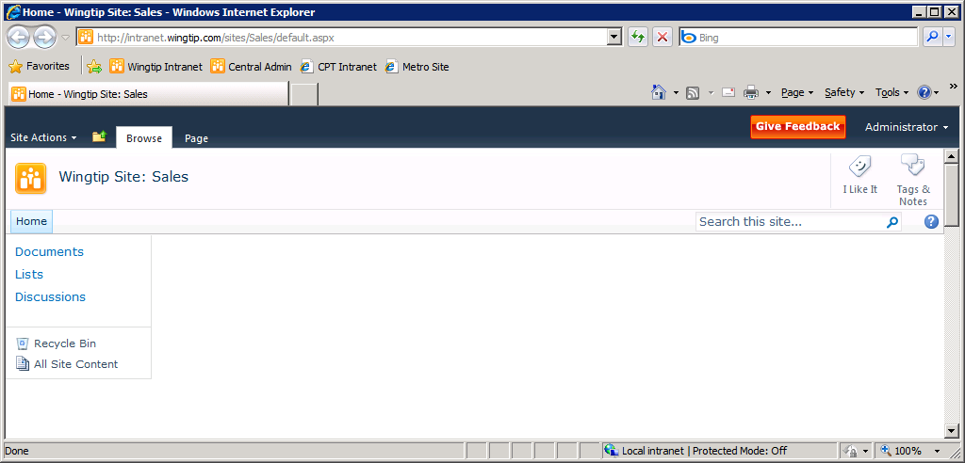
Examples of SharePoint Scripting
Notes:
The example shows a PowerShell script which uses the New-SPSitecmdletto create a new site. You should observe that the New-SPSitecmdletreturns a SPSite object which is then used to access the SPWeb object for the top-level site.

Slide 20
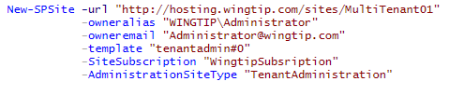
I Cant Find That Button
Not available in GUI Interface
Host Header Site Collection Creation
Multi-Tenant Setup
Notes:
There are some things that cannot be done in Central Admin. They can only be accomplished using PowerShell. A couple examples of these are the creation of Host Header Site Collections (Also can be created with STSADM) and the set-up of a Multi-Tenant Environment.
In Multi-Tenant there is a hidden site template that can only be called via PowerShell

Slide 21
DEMO
Writing Windows PowerShell Scripts

Slide 22
Additional PowerShell Resources
Windows PowerShell for SharePoint Foundation 2010
http://technet.microsoft.com/en-us/library/ee662510(office.14).aspx
Windows PowerShell Getting Started Guide
http://msdn.microsoft.com/en-us/library/aa973757(VS.85).aspx

Slide 23
Summary
Introduction to Windows PowerShell
The Windows PowerShell console window
Writing Windows PowerShell scripts
Using the SharePoint PowerShell Snap-in

